Slide 1
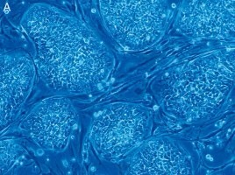
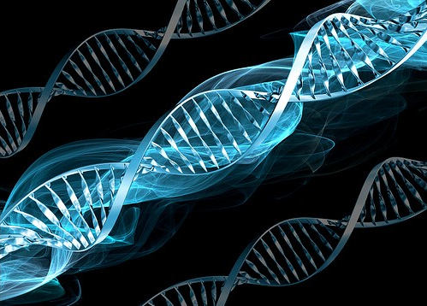
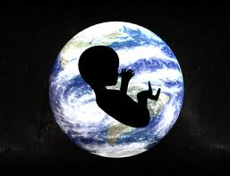
Bioethics Vs. Moral ethics? You Decide
Dr S D Sivasubramaniam
[SHIVA]
shiva.Sivasubramaniam@ntu.ac.uk
01158483455

Slide 2
Objectives of the Session
Discuss key ethical issues in relation to medical practice.
Recognise moral dilemmas are not always ethically correct.

Slide 3
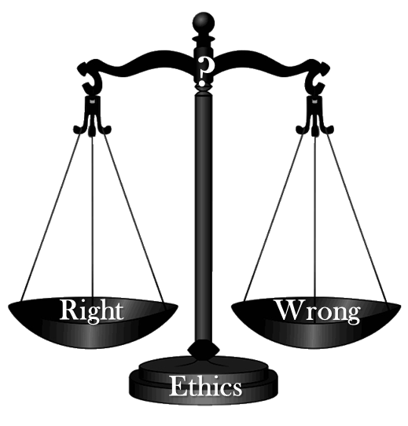
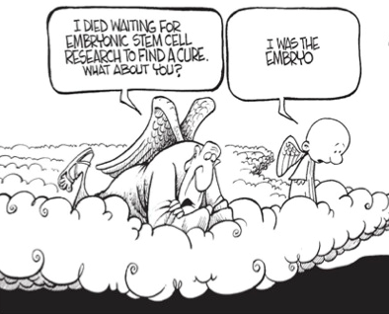
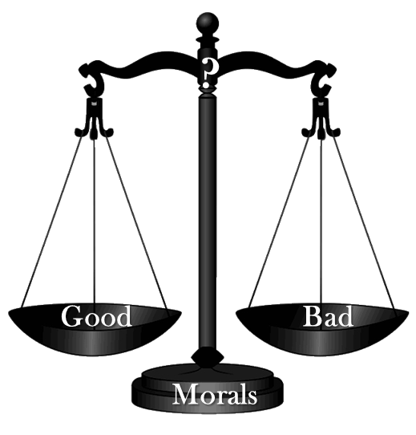
Who is affected by bioethics?
Figure adopted from https://sites.google.com/a/syd.catholic.edu.au/christian-bioethics-sor/

Slide 4
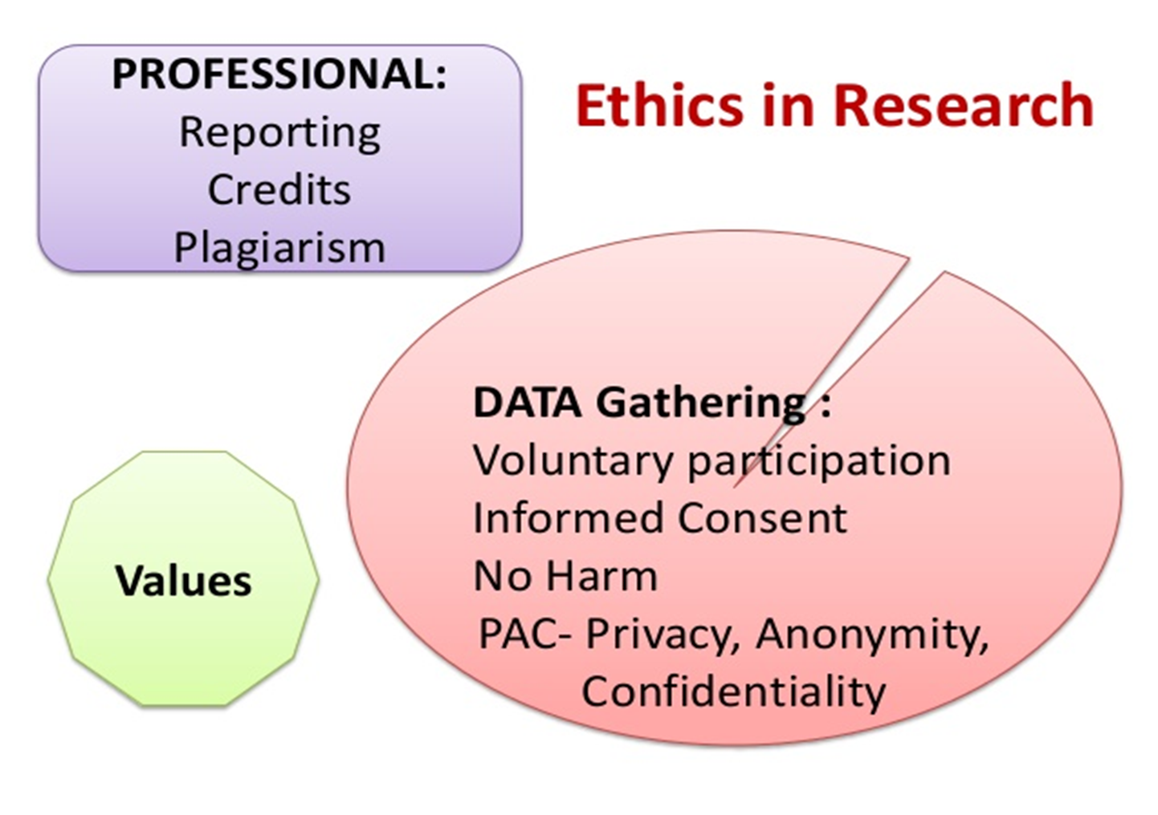

Slide 5
When ethics conflicts with “morals”
Ethics | Morals
“Character” (Cf. ethos – Greek) | “custom” (Cf. Mos – Latin)
External (imposed by the society) | Internal (self discipline)
Usually linked to an act of law | Usually linked to culture and/or religion
Freedom of Speech Vs. Religious criticism
Vaccine production Vs. Animal cruelty
Polygamy Vs. Cultural beleifs

Slide 6
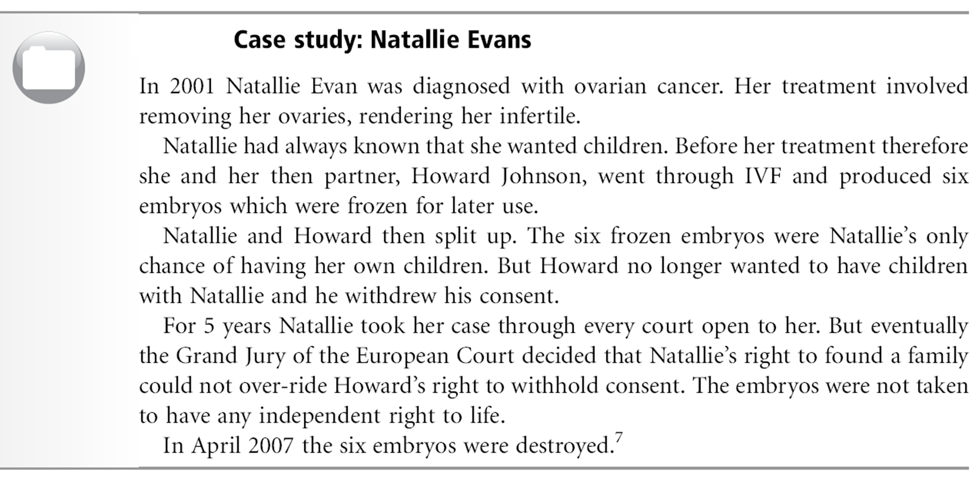
Reproductive freedom: rights, responsibilities and choice

Slide 7
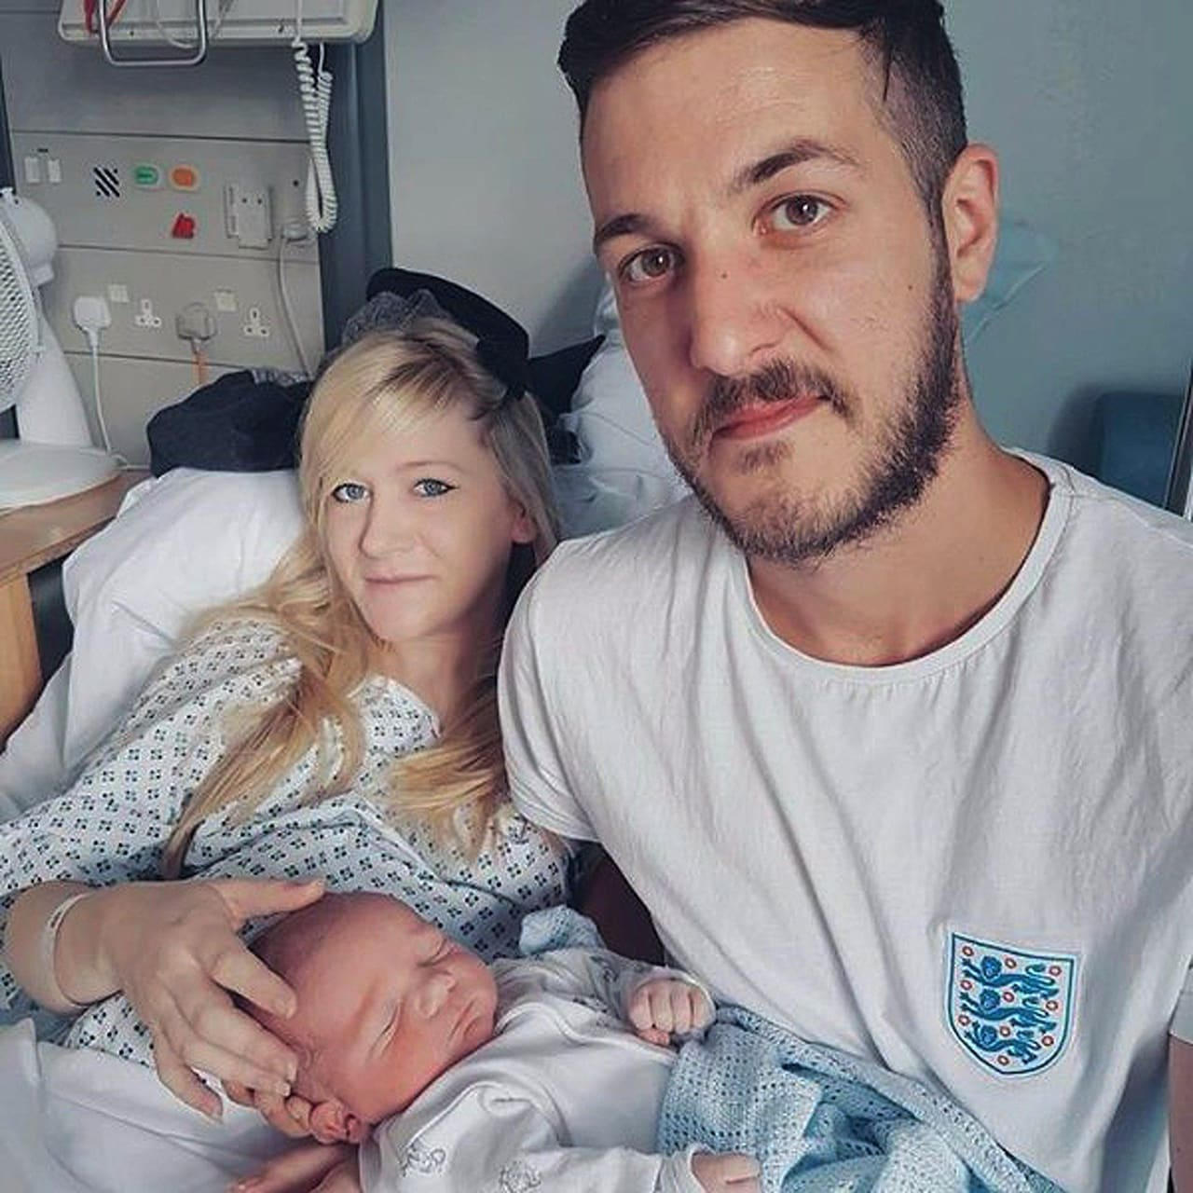
Parental autonomy: Rights, responsibilities and choice
II: Charlie Gard
Charlie was a 10-month old patient in intensive care at Great Ormond Street Hospital (GOSH) in London. Doctors discovered he had a rare inherited disease - infantile onset encephalomyopathy mitochondrial DNA depletion syndrome. The condition causes progressive muscle weakness and brain damage. Charlie's parents wanted to take him to see specialists in the USA, who had offered an experimental therapy. However GOSH physicians objected this and pleaded the courts that life support treatment should stop. Considering both the parents as well as the GOSH’ bosses, the judge concluded that life-support treatment should end and said a move to a palliative care regime would be in Charlie’s best interests. Then Charlie’s parents took their case through the Court of Appeal and the UK Supreme Court with no success. They appealed the verdict to the European Court of Human Rights but European judges refused to intervene. Charlie's parents ended their five-month legal fight over treatment for their terminally-ill son. Finally Charlie’s life-support was withdrawn.

Slide 8
Other ethical issues: Bioethics Vs. Moral ethics
Abortion
Euthanasia
Suicide
DNR
Determination of death
Cloning
Human Experimentation
Birth control
In vitro fertilization
Stem cell technology
Homosexuality

