Slide 1
Where is the Borderline of Plagiarism?
Dita Dlabolová
dita.dlabolova@academicintegrity.eu
Authors:
Irene Glendinning, Coventry University
Tomáš Foltýnek, Mendel University in Brno
Dita Dlabolová, Mendel University in Brno

Slide 2
Structure of the Workshop
Definitions of plagiarism and academic dishonesty
Judgment of cases
Reasons for plagiarism
Students’ and teachers’ views
Discussion
Background: EU funded project “Impact of Policies for Plagiarism in Higher Education across Europe”

Slide 3
Definitions…
What do you understand by plagiarism and academic dishonesty?

Slide 4
Defining Plagiarism
Using the work of someone else and presenting it as your own
Failing to correctly cite and reference the work of someone else
Not giving due credit for the contribution of someone else to your work

Slide 5
What do you understand by academic dishonesty?
Exam cheating
Self-plagiarism
Buying assignments (contract cheating)
Working together and inappropriate collusion
Research fraud
…

Slide 6
Why should we deal with it?
Why should be universities interested in plagiarism and academic integrity?

Slide 7
Where is the borderline?
Where is the borderline between poor academic practice and plagiarism?
Read through the questions provided and put ticks in the relevant box according to whether or not you think these describe plagiarism

Slide 8
Example from Mr. Apple‘s blog:
Carrot says about Lemon: Lemon is yellow. She also adds about him that he is a citrus. Then Carrot mentioned that Lemon is sour. And he is also bitter. Carrot also revealed a very surprising fact that Lemon grows on trees!

Slide 9
Example from Mr. Apple‘s blog:
Carrot says about Lemon: Lemon is yellow. She also adds about him that he is a citrus. Then Carrot mentioned that Lemon is sour. And he is also bitter. Carrot also revealed a very surprising fact that Lemon grows on trees!

Slide 10
Where is the borderline?
Focus on scenarios 1 and 6
Which of them is worse?
What do European students think about these cases?

Slide 11
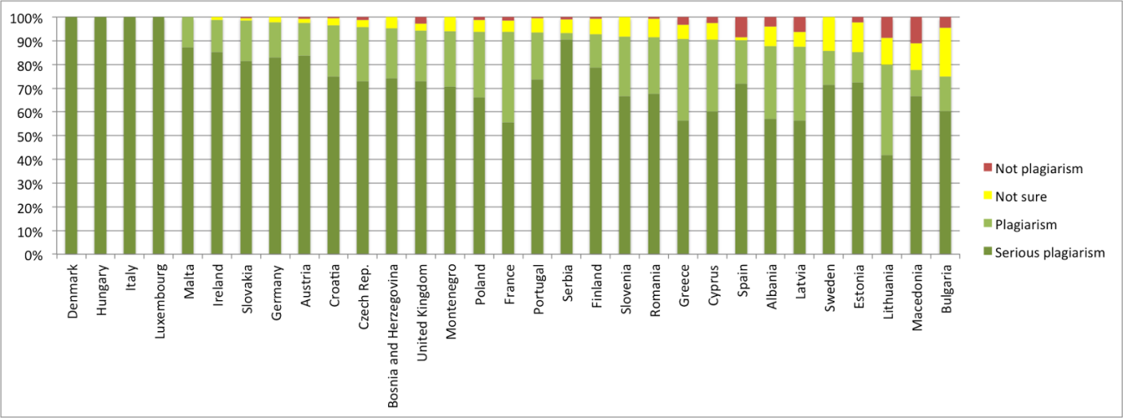
40% of student’s work copied word for word with no quotation, references or citations (1)

Slide 12
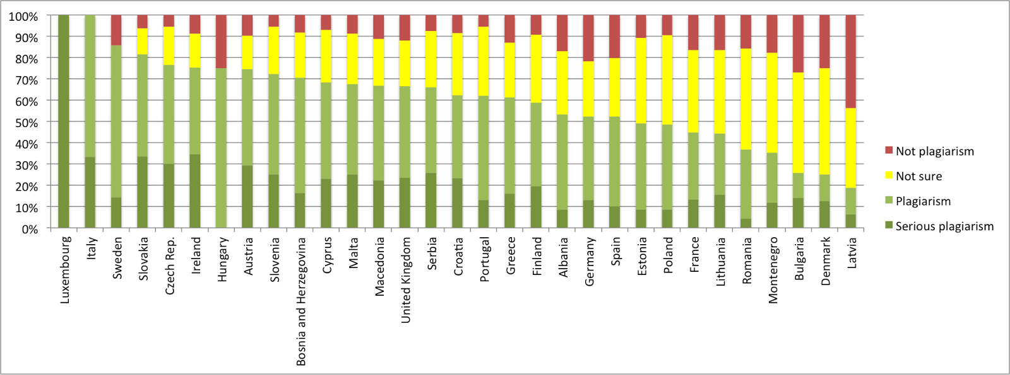
40% of student’s work copied some words changed, no quotations, references or citations (6)

Slide 13
Looking for reasons
Why do students plagiarise?
On your own write down as many reasons as you can think of in 2 minutes
Now share them with the people next to you

Slide 14
Students vs. teachers: Why do students plagiarize?
Teachers
it’s easy to cut and paste
plagiarism is not wrong
lecturer will not care
Students
run out of time
unable to cope with the workload
their own work is not good enough

Slide 15
Students vs. teachers
How students get to know about plagiarism?
Teachers: Class/workshop
Students: Web pages
What is difficult on academic writing?
Teachers: Referencing formats, citing and referencing
Students: Finding good sources, paraphrasing

Slide 16
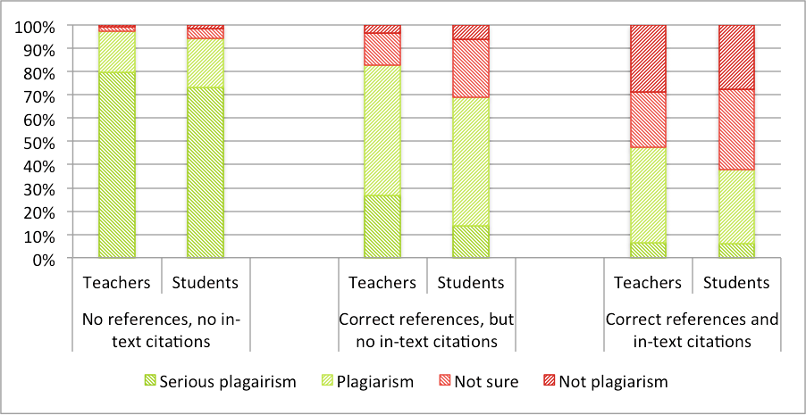
Students vs. teachers, scenarios 6, 7, 8: 40% copied, some words changed. Is it plagiarism?

Slide 17
What can be done about it?
On your own write down your ideas
Working in groups
Feedback to everyone

Slide 18
Discussion: Understanding plagiarism
Which categories of students are most likely to plagiarise?
Can it depend on the student’s background and previous experience? How, why?
Should we apply more severe penalties for postgraduate students and final year degree?
Should we be more benevolent for new students? All new students? How long for?
First offence? Three strikes and out?

Slide 19
Discussion: Preventing Plagiarism
Do students understand your expectations?
Training, guidance and support for students.
Testing to see whether students understand
Awareness of consequences and penalties
Staff training and development
Consistent approach and actions by staff
Use of tools – policy, training
What more could be done?

Slide 20
Back to First Activity: Where is the borderline?
Read through the questions you were given at the start of the workshop.
Do you wish to make any changes to the answers you gave earlier?
Put a ring around any answers you wish to change and tick the new answer
Did you make any changes?
Which cases are plagiarism?
How about penalties?

Slide 21
Our contacts
dita.dlabolova@academicintegrity.eu
www.mendelu.cz/en
www.plagiarism.cz/ippheae
www.plagiarism.cz/seeppai
www.academicintegrity.eu

