Slide 1
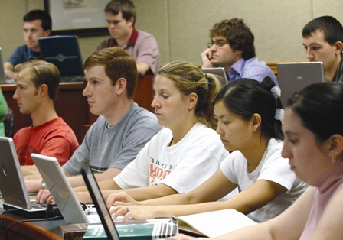
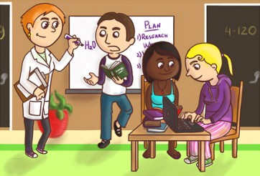
Detecting plagiarism – How hard is it?
Dr S D Sivasubramaniam
[SHIVA]
shiva.Sivasubramaniam@ntu.ac.uk
01158483455

Slide 2
Objectives of the Session
Highlight the key issues in relation to plagiarism detection using electronic text matching.
Critically evaluate some borderline examples.
Discuss the way forwards.

Slide 3
What is plagiarism?
”an attempt to gain advantage for yourself –
- academic advantage,
- financial advantage,
- professional advantage,
advantage of publicity
by trying to fool someone into thinking that you
- wrote something,
- thought something,
-or discovered something
which in actual fact, someone else wrote, thought, or discovered.”
- [Mc Naughton, 1995]

Slide 4
Academic theft/Dishonesty
Copying - using another person's language and/or ideas as if they are your own).
Inappropriate quote/paraphrase - Using another person’s sentences with minor/major modifications without acknowledgements
“Patch-working” - Slightly modifying another person’s sentences under the disguise of paraphrasing with or without citations.
Collusion – copying from your peers with or without their permission (unauthorized collaboration).
Self-plagiarising – Re-using or re-submitting your own work that was submitted before!
Buying from paper Mills – buying articles from external sources and submitting as your own

Slide 5
Common cause for plagiarism!
Not knowing
when and how to cite!
how to paraphrase!
What common knowledge is
Recycling an old paper!

Slide 6
Paraphrasing Vs. Patch-working!

Slide 7
Group work
Own Opinion
Validity
Conflicts
Approach
Decision
Justification

Slide 8
Group Discussion
Student behaviour
Contract cheating
Academic attitudes
Question Recycling
Institutional Policies
Self reflection
Global consistency
Common approach

