Slide 1
European Network for Academic Integrity
Tomáš Foltýnek
Mendel University in Brno
Czech Republic

Slide 2
Why?
Findings from previous research
Differences among countries and institutions
Bologna process → supporting student mobility, ECTS for evaluation of study effort, unification of standards
Many institutions
Lack of training (both teachers and students)
Management have no idea about the extent of students cheating
Lack of guidelines and fair approach
Will to learn from each other and cooperate

Slide 3
Roots of ENAI
IPPHEAE project (2010 – 2013)
Conference Plagiarism across Europe and Beyond 2013
Conference Plagiarism across Europe and Beyond 2015
Erasmus+ Strategic Partnerships project (2016 – 2019)
SEEPPAI project (2016 – 2017)
Conference Plagiarism across Europe and Beyond 2017

Slide 4
Inspiration
International Center for Academic Integrity (ICAI)
Asia-Pacific Forum on Educational Integrity (APFEI)
Nothing in Europe so far
Only 4 European HEI members of ICAI
European HEIs resist to join an „American“ network

Slide 5
European Network for Academic Integrity

Slide 6
Purpose of ENAI
to support
higher education institutions
to work together
in the field of
academic integrity

Slide 7
Objectives
to provide a platform for academics across all sectors to investigate, exchange, develop, collaborate and access resources
to offer opportunities for researchers
to present best practices
to make available a central point of reference
to organize conferences, workshops and other events
to network and collaborate with individuals and organizations actively pursuing related research
to collaborate towards research
to appreciate individual and institutional efforts by offering awards

Slide 8
Activities
Development of educational materials
Development of guidelines
Web page with resources
Regular newsletter
every 2 months
Annual conferences
Training events and workshops
Awards

Slide 9
Erasmus+ Strategic Partnerships Project
Sep 2016 – Aug 2019
12 partner institutions from 11 countries
Budget of 380 000 EUR
Three intellectual outputs
Educational materials for HEI teachers and students
Toolkit for cross-sectoral cooperation in terms of academic integrity
Handbook for improvements in academic integrity

Slide 10
Web Page & Newsletter
www.academicintegrity.eu
info@academicintegrity.eu

Slide 11
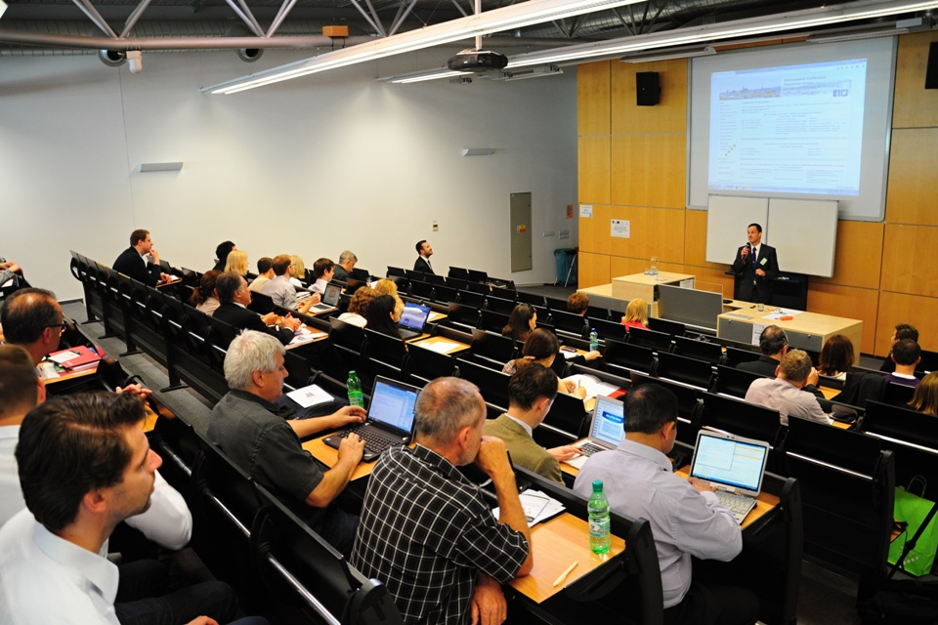
Annual Conferences
2017 Czechia
2018 Turkey
2019 Lithuania
2020 ??? – to be decided in 2018 in Turkey
2021 ??? – to be decided in 2019 in Lithuania
etc…
Place and organizer will be chosen
2 years in advance
presentation of candidates
ENAI members vote

Slide 12
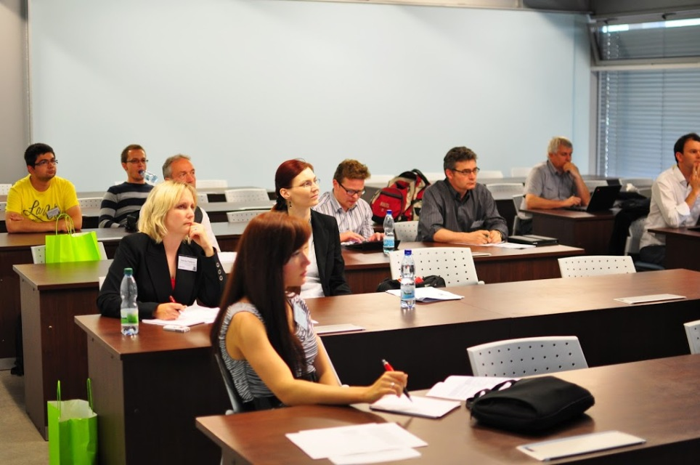
Training events
Open to ENAI members and supporters only
except the public part
One week in September
Workshops
Development of materials
Working in groups
Place and organizer to be announced 1.5 years in advance
Recommended to use Erasmus+ grants
staff mobility for teaching/training

Slide 13
Organization
Legal entity: Association registered in the Czech Republic
The Board: 5 members with 3 years tenure
natural persons
elected by representatives of member institutions
re-election not limited
President of the Board
elected by the Board
legal representative of ENAI
Staff
administrative staff
future: executive director

Slide 14
Organization
Auditing group: 3 members with 3 years tenure
natural persons
disjoint from the Board
control authority
Working groups
established and dissolved by the Board
responsible for particular activity
head of working group appointed and dismissed by the Board
Current working groups
Educational materials
Cross-sector cooperation
Handbook for improvements

Slide 15
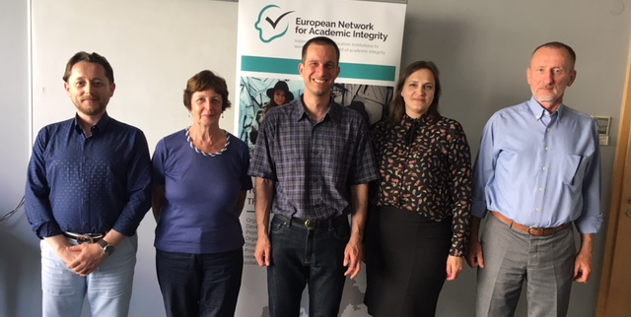
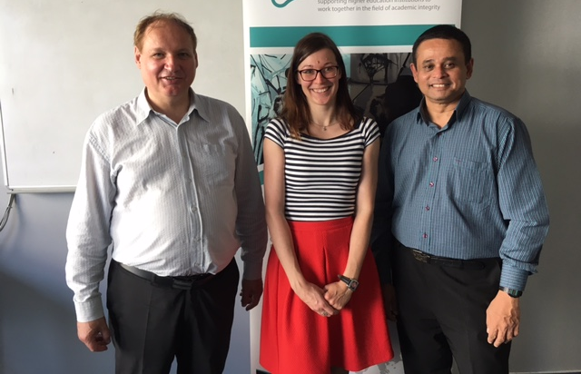
People
The Board
Tomáš Foltýnek (president) (CZ)
Irene Glendinning (UK)
Loreta Tauginiene (LT)
Salim Razi (TR)
Julius Kravjar (SK)
Auditing group
Milan Ojsteršek (head) (SI)
Shiva Sivasubramaniam (UK)
Dita Dlabolová (CZ)

Slide 16
Membership
Members: legal entities engaged in educational activities
Each member institution appoints a representative
Supporters: individuals
How to become a member
filling the application form
approval by the Board
payment of membership fee

Slide 17
Members‘ benefits
Part of the network → collaboration opportunities
Prestige → institution takes AI seriously, marketing tool
Can elect the Board and influence the network
Discounts on fees for ENAI events
Some events for ENAI members only
Discounts on fees for events organized by affiliated bodies
Can organize ENAI conferences and events
Rating system available for member institutions only
Access to consultants, experts, mentors and speakers
ENAI can subsidize
Regular newsletter, grant opportunities
Access to resources, online training
Notes:
EU and international collaboration
Mentoring – how to run projects, once project partner, next project leader

Slide 18
Fees and Budget
Goal: ENAI as self-funded network
Annual fee for institution: 300 EUR
Annual fee for supporters: 50 EUR
50% discount for the first year
Administrative staff costs
Web page, newsletter, management of resources
Support of ENAI activities
2017
Income
Fees 12 x 150 EUR = 1800 EUR
Expenditure
Administrative staff costs 6 x 300 EUR = 1800 EUR
2018
Income
Fees 12 x 300 EUR = 3600 EUR
Fees 6 x 150 EUR = 900 EUR
Expenditure
Administrative staff costs 12 x 300 EUR = 3600 EUR
Support of activities: 900 EUR

Slide 19
What we already have
Established legal body
9 member institutions
Funding for initial activities
Traditional conference
Web page, newsletter
Visual style, banner,…
Links to ICAI, APFEI, CoE ETINED
Group of enthusiastic people
Supportive social climate

Slide 20
What has to be achieved soon
Attract more members
Achieve Erasmus+ project outcomes
Work together with ETINED on CoE recommendations for member states
Start doing more activities
Rating system
Awards
Support of whistleblowers
Training events for staff

Slide 21
Thank you for your attention
Looking forward to your university becoming member of ENAI…
tomas.foltynek@academicintegrity.eu
info@academicintegrity.eu
www.academicintegrity.eu

